Slide 1

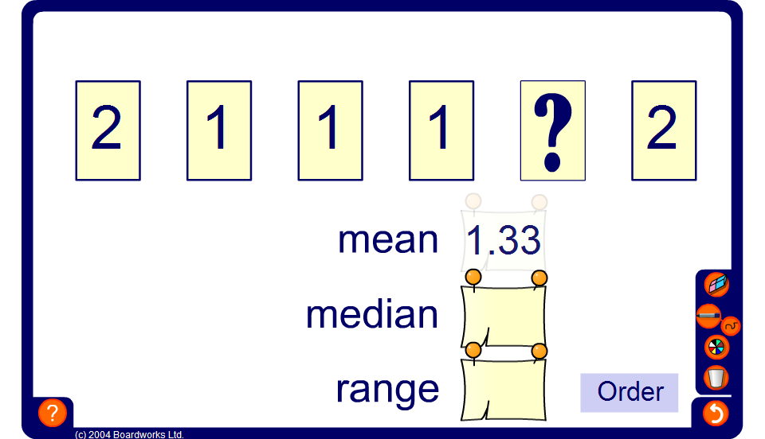


Find the missing value
Notes:
Pupils must use the information given to find the missing value.

